Slide 1
R. Johnsonbaugh
Discrete Mathematics
5th edition, 2001
Chapter 8
Network models

Slide 2
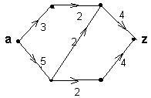
8.1 Introduction
A transport network (or simply network) is a simple, weighted, directed graph satisfying 1, 2 and 3:
1. A designated vertex with no incoming edges (the source a)
2. A designated vertex with no outgoing edges (the sink z)

Slide 3
Capacity
3. The number C_{i,j} > 0 assigned to each edge (i,j) is called the capacity of edge (i,j)

Slide 4
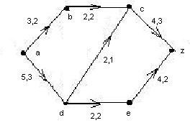
Flow
In the diagram, each pair a,b indicates:
a = flow
b = capacity
of the edge (i,j)
Given a network G with
capacity C_{i,j} at every edge (i, j)
A flow F_{i,j} is a number assigned to each edge (i,j) such that
0 < F_{i,j} < C_{i,j}
For every vertex i: the incoming flow equals its outgoing flow:
Σ F_{i,j} = Σ F_{j,i}

Slide 5
Flow at the source and at the sink
Value of the flow is the flow outgoing from the source, which equals the flow coming into the sink:
∑ F_{a,j} = ∑ F_{j,z}
^{j j}
Example:
  In the diagram,
  F_{a,b} + F_{a,d} = F_{c,z} + F_{e,z}
  3 + 5 = 4 + 4 = 8

Slide 6
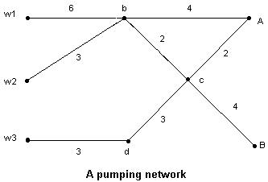
Pumping networks (1)
Water for two cities A and B is pumped from three wells w₁, w₂ and w₃
Capacities are shown on the edges

Slide 7
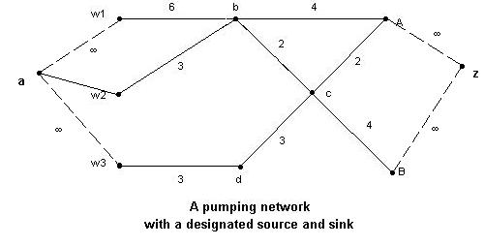
Pumping networks (2)
Adding two vertices a and z and their corresponding edges as in the diagram produces an equivalent transport network with supersource a and supersink z.

Slide 8
Computer network
Application of flow networks to computer networks:
  A vertex is a message or switching center
  An edge represents a channel on which data can be transmitted between vertices
  The capacity of an edge is the capacity in bps of that channel
  A flow on an edge is the average number of bps transmitted through the edge

Slide 9
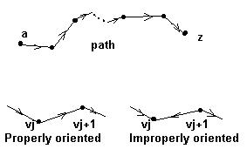
8.2 A maximal flow algorithm
If G is a transport network, a maximal flow in G is a flow with maximum value.
The algorithm consists of starting with some initial flow and increase it iteratively until no higher flow is possible.
v₀ = a (source)
v_{n} = z (sink)
Path P = (v₀, v₁,…, v_{n})
An edge (v_{i}, v_{i+1}) is properly oriented if its direction follows the direction of the path.
It is improperly oriented otherwise.

Slide 10
Finding a greater flow (1)
Theorem 8.2.3: Let P be a path from a to z in a network G with capacity C and flow F,
satisfying the conditions:
a) For each properly oriented edge (i,j) in P,
F_{i,j} < C_{i,j}
b) For each improperly oriented edge (i,j) in P,
0 < F_{i,j}
Let X_{i,j} = C_{i,j} – F_{i,j} if (i,j) is properly oriented
F_{i,j} if (i,j) is improperly oriented

Slide 11
Finding a greater flow (2)
Let ∆ = minimum {X_{i,j}} _{i,j= 1,...,n}
Define F_{i,j}*=
  F_{i,j} if (i,j) is not in P
  F_{i,j} + ∆ if (i,j) is properly oriented in P
  F_{i,j} - ∆ if (i,j) is improperly oriented in P
Then:
F* = {F_{i,j}*} is a flow whose value is F + ∆

Slide 12
8.3 The max flow, min cut theorem
Let G be a network with flow F
Let P = (labeled vertices} and P' = {unlabeled vertices}, source a ∈ P and sink z ∈ P'
Define a cut S = {(v,w) | v ∈ P, w ∈ P'}
Capacity of S is C = ∑ C_{i,j} where (i,j) ∈ S
Theorem 8.3.7: Given a cut S, C > F.

Slide 13
Max flow, min cut theorem
Theorem 8.3.9
(Max flow, min cut theorem): Capacity of the
cut S = F if and only if
F_{i,j} = C_{i,j} for i ∈P, j ∈P' or
F_{i,j} = 0 for i ∈P' and j ∈ P
In this case, flow F is maximal and cut S is
minimal

Slide 14
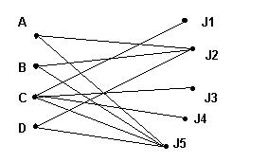
8.4 Matching
Example: 4 applicants A, B, C and D apply to five jobs J_{k}, 1 < k < 5.
The edges represent qualification for a job.
A matching consists of finding jobs for qualified persons

Slide 15
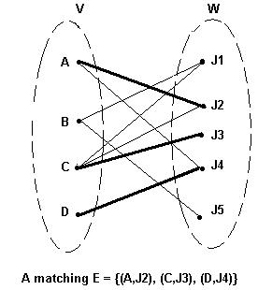
Definition of matching
Let G be a directed, bipartite graph with disjoint vertices V and W in which the edges are directed from V to W
A matching for G is a set of edges with no vertices in common.

Slide 16
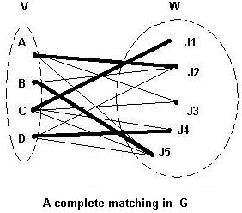
Maximal and complete matching
A maximal matching for G is a matching E which contains the maximum number of edges
A complete matching for G is a matching E with the property that for every v ∈ V, then (v,w) ∈ E for some w ∈ W.

Slide 17
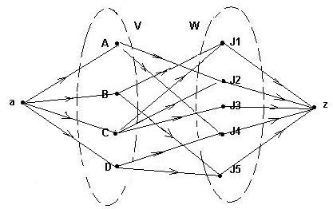
Matching network
Given a bipartite directed graph G with V and W its disjoint sets of vertices,
Assign to each edge capacity 1.
Add a supersource a and a supersink z.
Add edges of capacity 1 from a to vertices in V and from vertices in W to z
The resulting network is a matching network

Slide 18
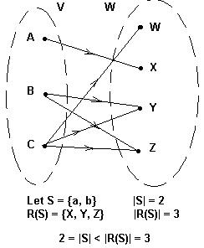
Hall's marriage theorem
Let G be a directed, bipartite graph with disjoint sets of vertices V and W and with directed edges from V to W.
Let S ⊆ V.
Let R(S) = {w ∈ W | v ∈ S and (v, w) is an edge in G}
Then: there exists a complete matching in G if and only if
|S| < |R(S)| for all S ⊆ V.

